Slide 1
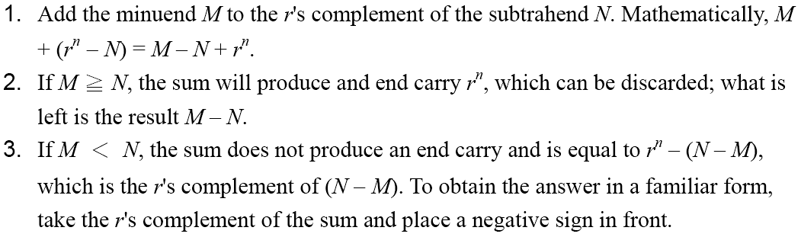
Complements
 Subtraction with Complements
◆ The subtraction of two n-digit unsigned numbers M – N in base r can be done as follows:

Slide 2
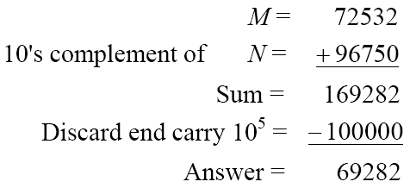
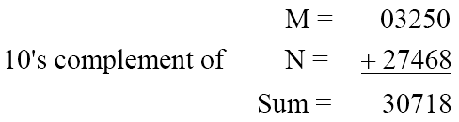
Complements
 Example 1.5
◆ Using 10's complement, subtract 72532 – 3250.
 Example 1.6
◆ Using 10's complement, subtract 3250 – 72532.
There is no end carry.
Therefore, the answer is – (10's complement of 30718) = − 69282.

Slide 3
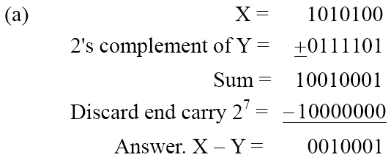
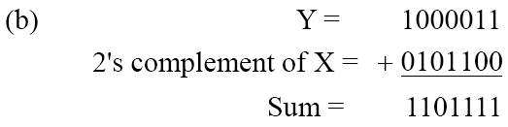
Complements
 Example 1.7
◆ Given the two binary numbers X = 1010100 and Y = 1000011, perform the subtraction (a) X – Y ; and (b) Y − X, by using 2's complement.
There is no end carry.
Therefore, the answer is
Y – X = − (2's complement of 1101111) = − 0010001.

Slide 4
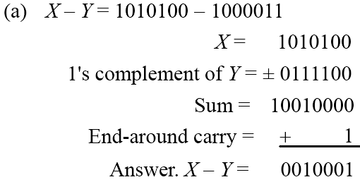
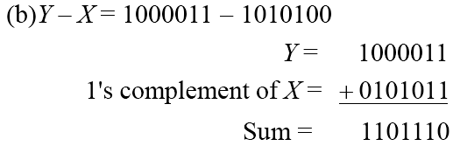
Complements
 Subtraction of unsigned numbers can also be done by means of the (r − 1)'s
complement. Remember that the (r − 1) 's complement is one less then the r's complement.
 Example 1.8
◆ Repeat Example 1.7, but this time using 1's complement.
There is no end carry, Therefore, the answer is Y – X = − (1's complement of
1101110) = − 0010001.

